Slide 1

CMR COLLEGE OF ENGINEERING & TECHNOLOGY
Kandlakoya, Medchal, Hyderabad - 501401
Department of Computer Science and Engineering
Text and Video summariation using ML
Name of the student
Sumit Chelluru (20H51A05F6)
Karthik Adepu (20H51A0536)
Y.Sanjana (20H51A05M5)
Under esteemed guidance of
Dr. S. Kirubakaran

Slide 2
Outline
Abstract
Introduction
Research Objective
Problem Definition
Scope of the Project
Literature Review
Implementation of Existing system
Conclusion
References
Notes:
2

Slide 3
Abstract
Notes:
3

Slide 4
ABSTRACT
The Text and Video Summarization tool is a revolutionary approach to manage time and immense amount of data; one must go through. Current text summarization tools struggle to summarize large text files accurately and consistently, especially when dealing with different document formats and file lengths.
This tool efficiently handles condenses large amounts of text to meet the growing need for more efficient information consumption accessible to all with a user-friendly interface. By integrating innovative methodologies, advanced NLP techniques, and a diverse dataset enriched with human insights, this project aims to advance the field of automated text summarization, contributing to more effective information condensation.
The tool streamlines text summarization as well as video summarization capabilities into one umbrella, providing its users option and choice of even summarizing audio as well, this system offers a seamless and responsive solution. It contributes to a more efficient use of existing resources by producing summaries, making time management efficient and effective.

Slide 5
INTRODUCTION
Notes:
5

Slide 6
Introduction
Information is abundant and found all around , sometimes the sheer amount of data can become abundant for anyone new and wants to learn from the research papers. Individuals often spend lot of time before they get to a the exact detail that they need
To address these challenges and improve the time needed to make the information at our hand really useful , text summarization tool helps the users with the hassle of going through the pile of papers before choosing the one they actually need by using NLP and summarizing the research papers, documents, etc. and presenting information in byte sized passages which distill the information in those papers and save time of the users
Notes:
6

Slide 7
Research Objective
Notes:
7

Slide 8
Research Objective
To develop a sophisticated and contextually aware text summarization system using the latest natural language processing (NLP) techniques, with an emphasis on improving extractive and abstractive summarization capabilities.
The principal objective is to enhance the effectiveness, precision, and consistency of text summarization in many fields, taking into account variables like document length, linguistic subtleties, and user-specific needs. Furthermore, the study intends to investigate new methods for managing the summarizing of many documents and modifying the summarization model to accommodate different inputs. By tackling issues with automatic summary, the project hopes to advance the field of natural language processing (NLP) and improve the efficiency and accessibility of information condensation across a range of applications, such as news aggregation and document summarization.
Notes:
8

Slide 9
Problem Definition
Notes:
9

Slide 10
Problem Definition
Despite the increasing volume of information available, the efficient extraction of key content from large textual datasets remains a significant challenge.
Existing text summarization tools face challenges in accurately and coherently summarizing large textual datasets, especially in the presence of diverse document structures, languages, and lengths.
The envisioned text summarization tool aims to be versatile, finding applications in diverse contexts such as document summarization, news aggregation, and content curation.
The overarching problem is to advance text summarization technology, overcoming current limitations and providing a more robust solution to distill essential information from varied and extensive textual sources.
Notes:
10

Slide 11
Scope of the project
Notes:
11

Slide 12
Scope of the project
Explore various possibilities of diverse datasets for text summarizer to learn form
Implementation of various algorithms to provide both extractive as well as abstractive abilities to the tool.
The tool's scope encompasses user-centric features, allowing customization to meet individual preferences or specific requirements. This involves incorporating user feedback mechanisms and parameters to tailor the summarization output to user expectations..
The scope includes making sure the text summary tool may be used in a variety of fields, businesses, and topic areas. This entails building in mechanisms to comprehend and process context-specific jargon and information specific to various topic fields.
Notes:
12

Slide 13
Literature Review
Notes:
13

Slide 14
Comparison table for the existing system
S.No | Authors and Journal Name& Year of publication | Problem Statement | Name of the Proposed solution/Method | Solution | Remarks
1 | Rahul, Saurabh Adhikari Monika 2020 Fourth International Conference on Computing Methodologies and Communication, 2020 | NLP based Machine Learning Approaches for Text Summarization | The methods described in this paper produce Abstractive (ABS) or Extractive (EXT) summaries of text documents. Query-based summarization techniques are also discussed. | The paper discusses the structured based and semantic based approaches for summarization of the text documents | The paper concludes by mentioning the focus on both abstractive and extractive summarization methods is good. It suggests a broad exploration of techniques, considering both the extraction of existing sentences and the generation of new ones..
2 | Farzad Kiyani Press Academia Procedia 205-213 (2017) | A SURVEY AUTOMATIC TEXT SUMMARIZATION | A SURVEY AUTOMATIC TEXT SUMMARIZATION using NLP and Stastical approach | The text mentions that the paper provides a comparative study of various text summarization techniques. This sets a clear expectation for readers regarding the paper's focus and goal.. | The explanation of extractive summarization is concise and highlights the method's reliance on selecting high-ranking sentences based on word and sentence features. The consideration of statistical and linguistic features for sentence importance adds depth to the explanation.
3 | Kiaz Merchant, Yash Pandey Gangey Mishra, 2018 International Conference on Advances in Computing, Communications and Informatics, Vol. 8, Issue 4, September 2018 | NLP Based Latent Semantic Analysis for Legal Text Summarization | Latent Semantic analysis | The mention of using latent semantic analysis (LSA), a natural language processing technique, demonstrates a commitment to employing advanced technologies for information extraction.. | The inclusion of two approaches, a single document untrained approach and a multi-document trained approach based on case types (criminal or civil), showcases adaptability to different scenarios. This tailored approach indicates a thoughtful consideration of the diverse nature of legal documents..

Slide 15
Implementation of Existing system
Select the type of summary you want: abstractive or extractive.
Gather various datasets that include summaries and accompanying text.
Clean and format the data as a preprocessing step.
Use Text Rank or machine learning algorithms for extractive.
Tokenize the text by assigning number vectors to each word.
Models are trained with labeled data.
Adjust for certain summarizing assignments.
Include the model in batch or real-time processing applications.
Notes:
15

Slide 16
Proposed method

Slide 17
Proposed method
The proposed method for summarization we are going to use Gradio, Pytube, transformers, and others. Audio processing is a key component, utilizing libraries like Pyaudioconvert, transformers for Wav2Vec2.0, and the Bert summarizer. The code facilitates the extraction of information from YouTube videos by utilizing the Pytube library and processing the resulting audio with the assistance of MoviePy and Pydub. the text as summarization capabilities using the Bert-extractive-summarizer library.
We can convert the summary of text into pdf using Fpdf. Ffmpeg is a command-line tool and a multimedia framework that can be used to record, convert, and stream audio and video. The Gradio library is used to create a user-friendly web interface, enabling users to interact with the tool by providing YouTube video URLs, recorded video names, audio names, or text for summarization. The code is organized into modular functions and packages, enhancing readability and maintainability. the project adopts a systematic approach, making use of pre-trained models and algorithms to carry out tasks such as text summarization, punctuation, capitalization, and audio-to-text conversion. Overall, the implemented code showcases an integrated solution for AI-powered note generation with a user-friendly interface.

Slide 18
Proposed System Architecture

Slide 19


System Architecture
Input module
user
interface
Pytube, wav2vec2
Moviepy, wav2vec2
Bert, wav2vec2
Bert model
YouTube video processing
Recorded video processing
Recorded audio processing
Text summarization
user
interface

Slide 20
Result Analysis

Slide 21
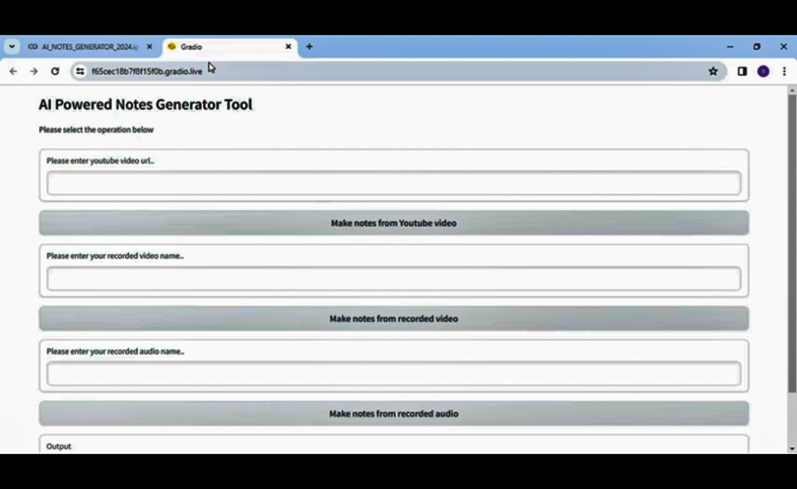
Results
The text summarization project starts by collecting a diverse set of documents and preparing them for analysis. Utilizing a machine learning model, such as a Transformer-based architecture, the system learns to extract key content and generate concise summaries.
Notes:
21

Slide 22
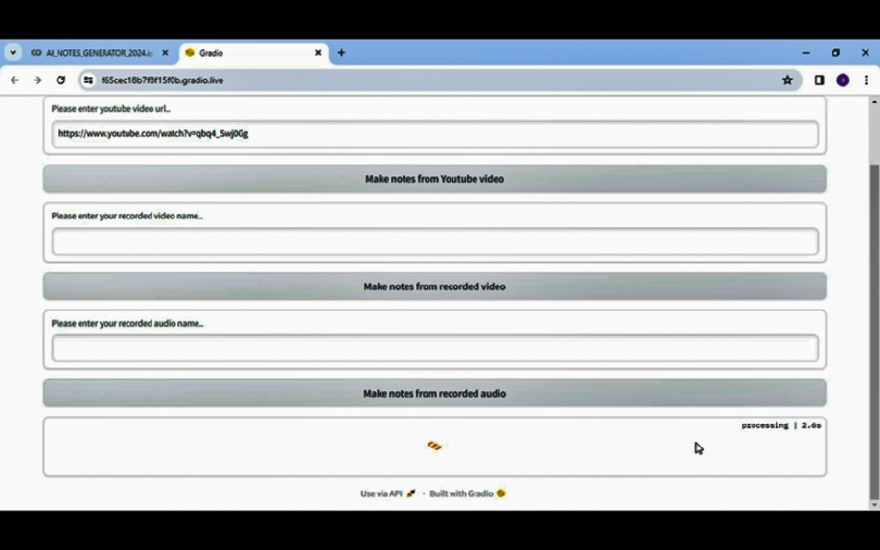
Results
Users interact with the system through a user-friendly application, capturing text input via mobile or PC. The model processes the input and produces abstractive summaries, preserving the essential information from the original text.
Notes:
22

Slide 23
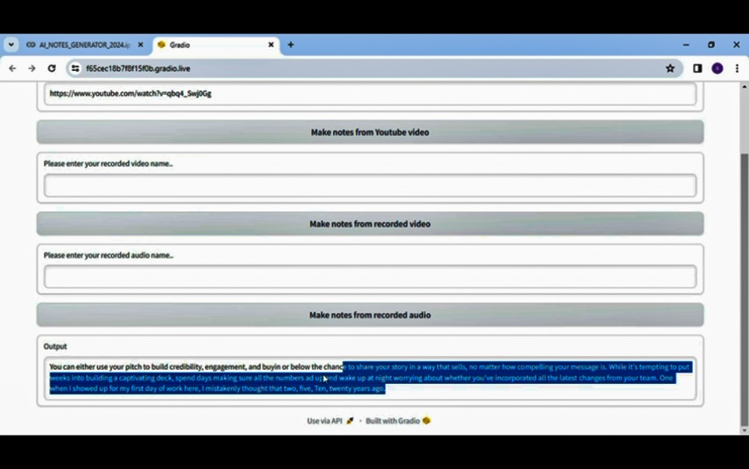
Results
The system incorporates checks for specific summarization features, adapting to different document types and styles. It continuously improves through updates and user feedback, ensuring relevance in the face of evolving language patterns.
Ethical considerations are paramount, with the system designed to adhere to legal standards and privacy regulations. Quality control mechanisms review generated summaries to confirm accuracy and maintain high standards of output.
Notes:
23

Slide 24
Future Works
Implementation of a localized tool that would run natively on the device of the users
Summarizing the text is still a work in progress in several research areas and needs to be further researched and developed in the summary of the texts.
Streamlining the user interface and providing smoother user experiences
Implementation of various models to expand the usability for the users
Providing a slider to which would add convenance to its users to decide upon the length of the summary
Notes:
24

Slide 25
Conclusion
With the huge amount of data available on the internet, extracting the top data as a concept brief would be useful for some users. Since there is a huge amount of data deployed on the internet, there is always a need to find a way to reduce the length of the text and provide a clear summary.
Summarizing the text is still a work in progress in several research areas and needs to be further researched and developed in the summary of the texts. Due to the huge increase in the amount of data available online, extracting the top information as a conceptual summary will be useful for some researchers.
In this paper we have drawn the reader’s attention to the latest and main data problems as well as the need to summarize the texts and explained how short texts can be useful while keeping the original texts intact.
The optimization way can also be used to solve different problems.
Notes:
25

Slide 26
References
https://www.researchgate.net/publication/257947528_Text_SummarizationAn_Overview
https://www.researchgate.net/publication/366231011_Text_Summarization_using_NLP_Technique
https://www.researchgate.net/publication/337653638_Text_Summarization_A_Brief_Review
https://www.researchgate.net/publication/220974615_Automatic_Text_
Summarization_Using_a_Machine_Learning_Approach

Slide 27
Thank You!

